Slide 1
Will Code For Food
Cru Central Coast Android Application

Slide 2
Features
Campuses & Ministries
Home Page Feed
Summer Missions
Events
Ride Sharing
Ministry Teams
Resources

Slide 3
Partially Completed/Not Completed
Community Groups (partially done)
Resource Tags

Slide 4
What Went Well
Working with Kyle
Android Studio
Great team!
Card Layout

Slide 5
What We Would Do Differently
Architecture of User Interface
Testing
Material Design for everything
Use Libraries
Form Validation
JIRA

Slide 6
Demo
Notes:
Brian: Introduction
Shelli: Home feed, filtering/search, cashing, summer missions
Mason: Events
Mallika: Ridesharing, community groups
Kayla: Resources
Brian: wrap up

Slide 7
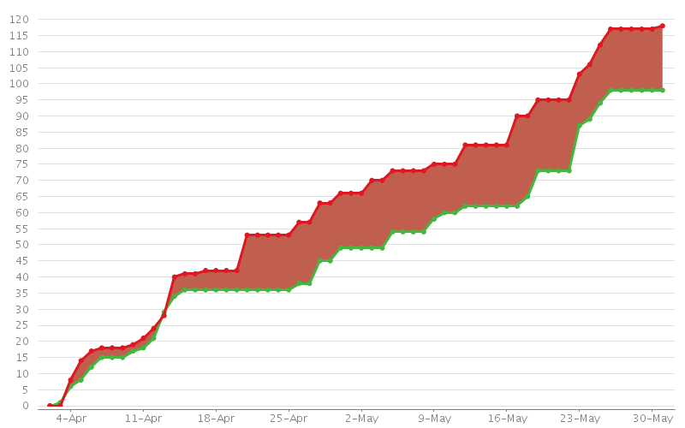
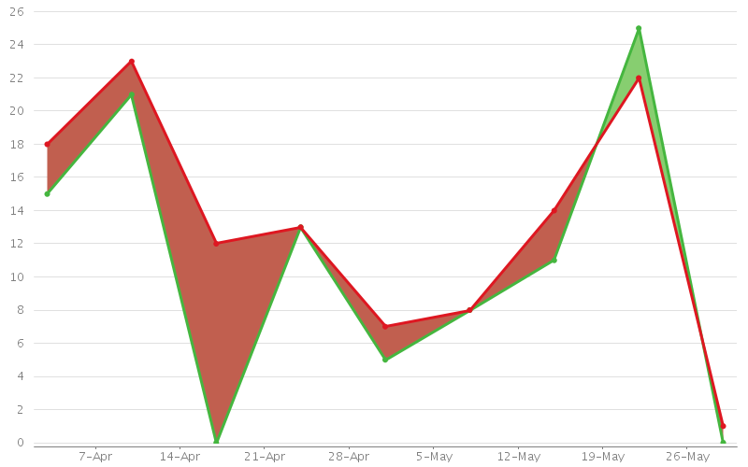
Bug Reporting
This chart shows the number of issues created (red) vs. the number of issues resolved (green) in the last 60 days.
Total Created - 118
Total Resolved - 98

Slide 8
Thank you!

